Slide 1
Welcome to Blazor
张善友
Notes:
BETH TODO: Add a little context on what these “Focus” events are and that we’ll be bringing you more in the coming year….

Slide 2


.NET
Your platform for building anything
Desktop
Web
Cloud
Mobile
Gaming
IoT
AI
Notes:
You can build anything with .NET.
We’ve made significant investments in .NET over the years as well as unifying the ecosystem to support building literally anything. From desktop to gaming to the cloud, .NET is a general purpose programming platform that enables all kinds of application scenarios. Once you learn one, you can easily pick up another.

Slide 3






前端发展历程
Webassmbly登场
2017
低代码/Low代码时代
2016
移动化时代来临
2014
前后端分离
全栈的演进
2013
工程化的开启
2008
结构+样式+行为分离
2003年

Slide 4
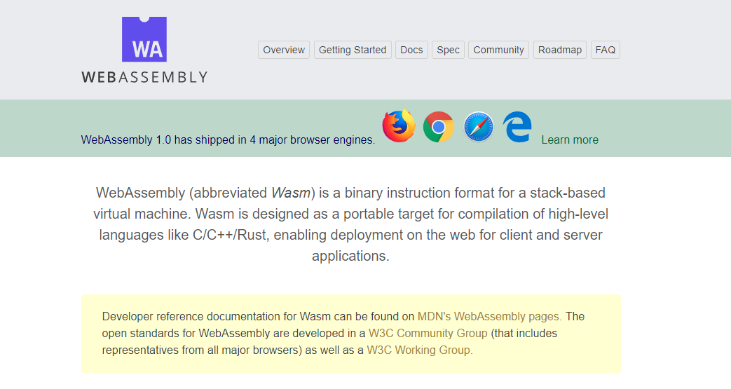

WebAssembly.org
文档: https://webassembly.org/docs/high-level-goals/

Slide 5









WebAssembly Working Group https://bit.ly/32yDOCP
Members from industry leaders:

Slide 6
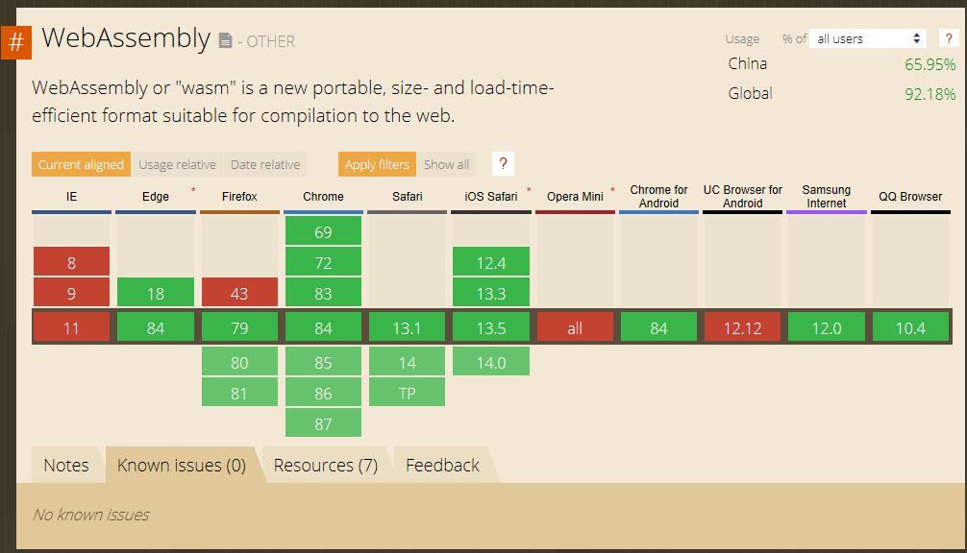
WebAssembly 兼容性
Source: https://caniuse.com/#search=wasm

Slide 7
Blazor 是什么?
Notes:
https://www.cnblogs.com/shanyou/p/12825845.html

Slide 8

.NET Core 3.1 & 5.0 Preview8
3.1 Long-Term Support (LTS)
Side-by-side support & self-contained EXEs
5.0 Preview8
Blazor: Full-stack web development with C# and Razor
Notes:
.NET Core 3.1 released last month so go get it!
We’ve added Windows Desktop support with Windows Forms and WPF support. This brings the capabilities of .NET Core to these UI frameworks. Particularly, flexible deployment with side-by-side and self-contained EXEs so you don’t have to have .NET installed on the machine first anymore.
We also have some exiting new things for Web developers with Blazor, which is what we’ll be talking about ALL DAY!, adding full-stack web development with C# and Razor, allowing you to build beautiful and responsive Single Page Apps without having to write JavaScript!
Additionally we have a ton of improvements for building better cloud native, scalable apps and services with ASP.NET as well as some exciting C# 8.0 language features.
<CLICK>

Slide 9






https://...
.NET
JS

Slide 10


Blazor
使用.NET 替代JavaScript构建 客户端web UI
使用 C# 和 Razor编写重用的web UI 组件
在客户端和服务端共享.NET代码
根据需要调用 JavaScript libraries & 浏览器 APIs
C#

Slide 11
Blazor 工作原理
Blazor Server
https...
ASP.NET Core
SignalR
DOM
Razor Components
.NET
.NET Core 3.1 LTS

Slide 12
Blazor 工作原理
Blazor WebAssembly
https://...
Razor Components
DOM
.NET
WebAssembly
Preview

Slide 13


共享组件模型
Blazor Server
Blazor WebAssembly
https...
https://...
ASP.NET Core
Razor Components
DOM
SignalR
DOM
.NET
Razor Components
WebAssembly
.NET
.NET Core 3.1 LTS
.NET Core 3.1 LTS
.NET 5

Slide 14

WebAssembly 工作原理
.NET Standard 2.1 构建
Delivered to browser
WASM alongside JS/HTML/CSS
MyBlazorClient.dll
MyBlazorClient.dll
JS
dotnet.wasm + Supporting files
dotnet.wasm + Supporting files
Referenced Assemblies
Referenced Assemblies
Referenced Assemblies
Referenced Assemblies
HTML
CSS
Referenced Assemblies
Referenced Assemblies

Slide 15




开始使用 Blazor
访问Blazor网站 https://blazor.net
安装 .NET Core 3.1
安装 Blazor WebAssembly 模板
Visual Studio
2019 16.4
Visual Studio for Mac
8.4
Visual Studio Code
+ C# extension

Slide 16
Blazor 实战
Notes:
Creating components
Using components
Component parameters
Routing
Layouts
Dependency injection
Event handling
Data binding
Forms & validation
Using .NET Standard libraries

Slide 17
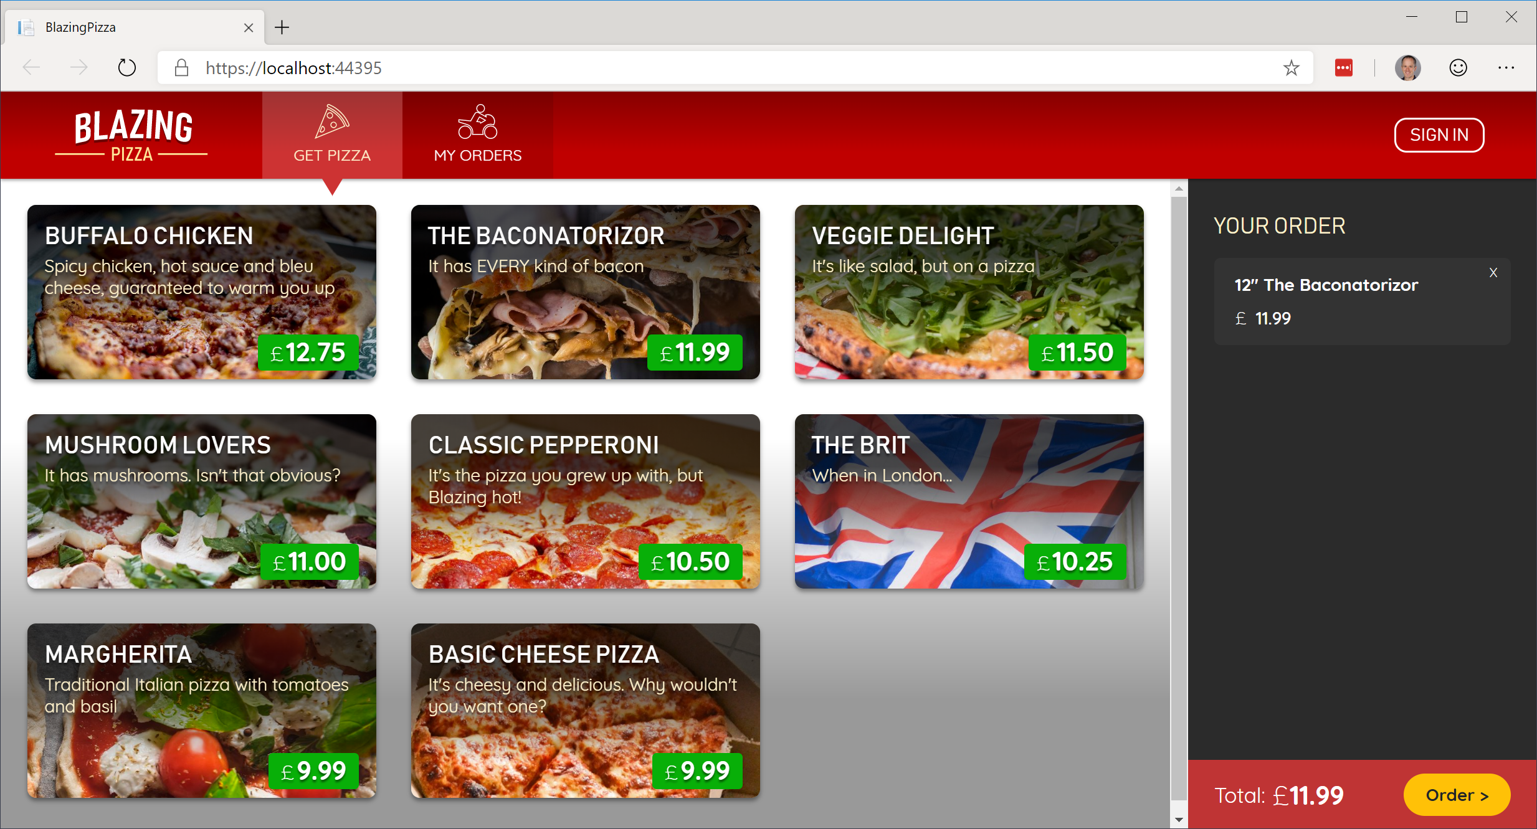
使用 Blazor 构建你的披萨网店界面
https://github.com/BlazorHub/blazor-workshop/tree/zhcn

Slide 18
Blazor Server 的扩展
测试活动的客户端交互延迟 (<200ms)
可用内存是主要瓶颈，不要每个用户加载几万条数据
实际应用行为将取决于应用内存使用情况、客户端行为和网络条件
利用 Azure SignalR Service
https://github.com/aspnet/AzureSignalR-samples/tree/master/samples/ServerSideBlazor
Instance size | Concurrent active users
Standard_D1_v2 (1 vCPU, 3.5 GB) | 5,000+
Standard_D3_V2 (4 vCPU, 14 GB) | 20,000+

Slide 19


那些公司已经在用Blazor 以及他们的评价…
“Pivotal is all about speeding up the path to production. That's why it invests in Steeltoe to provide its customers with a quick and easy way to build cloud-native .NET apps. And why we chose Blazor to create the Steeltoe website – Blazor makes it simple to design websites using C#.”
– David Dieruf, Product Marketing Manager, Pivotal Software
"We’re really impressed with .NET Core 3.1 and Blazor which has boosted our productivity, vastly improved the quality of our front-end code, and significantly reduced the amount of Javascript in our application to just 51 lines of code.“
– Matheus Guimaraes, Co-Founder & CTO at Deployed.

Slide 20


那些公司已经在用Blazor 以及他们的评价…
"We're extremely happy with Blazor as the UI for our broadcast TV equipment. Blazor server made it simple to render data from our hardware subsystems and we were able to rapidly develop a unified front-panel and remote UI for use on a range of products."
– Will Dean, Product Development Engineer, Videosys Broadcast
“BST Global is a leader in delivering innovative ERP and business management software solutions for the Architectural, Engineering and Consulting industry. We are currently exploring the use of Blazor technology with BST’s .NET Extensibility Platform and API to support its future web surface strategy because it keeps our developers more productive in C#.”
– Darren Johnson, Sr. Manager Software Engineering, BST Global

Slide 21
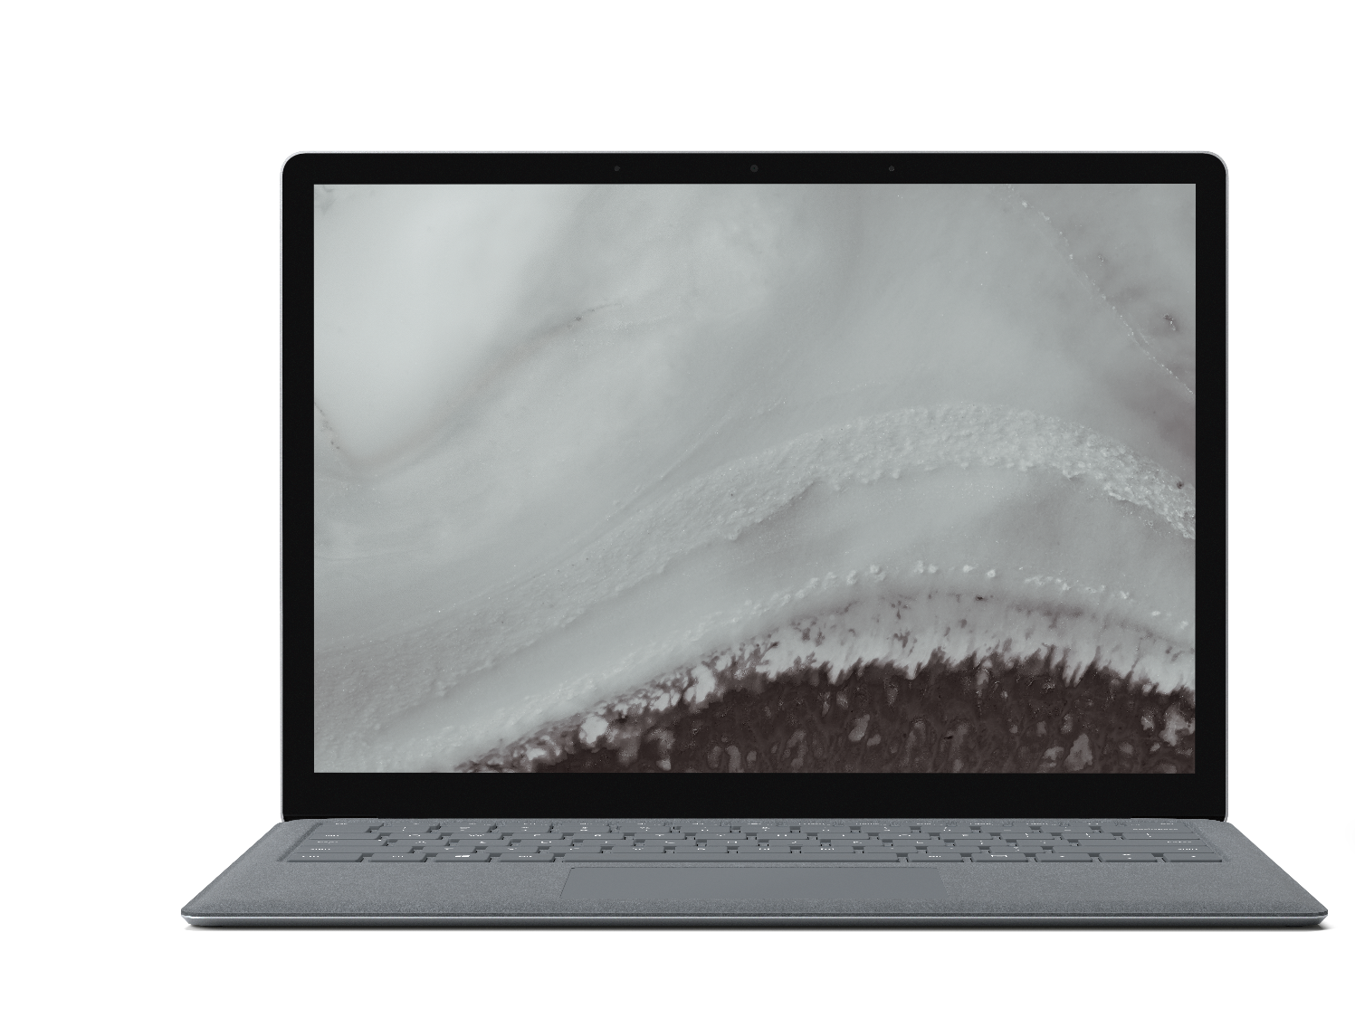

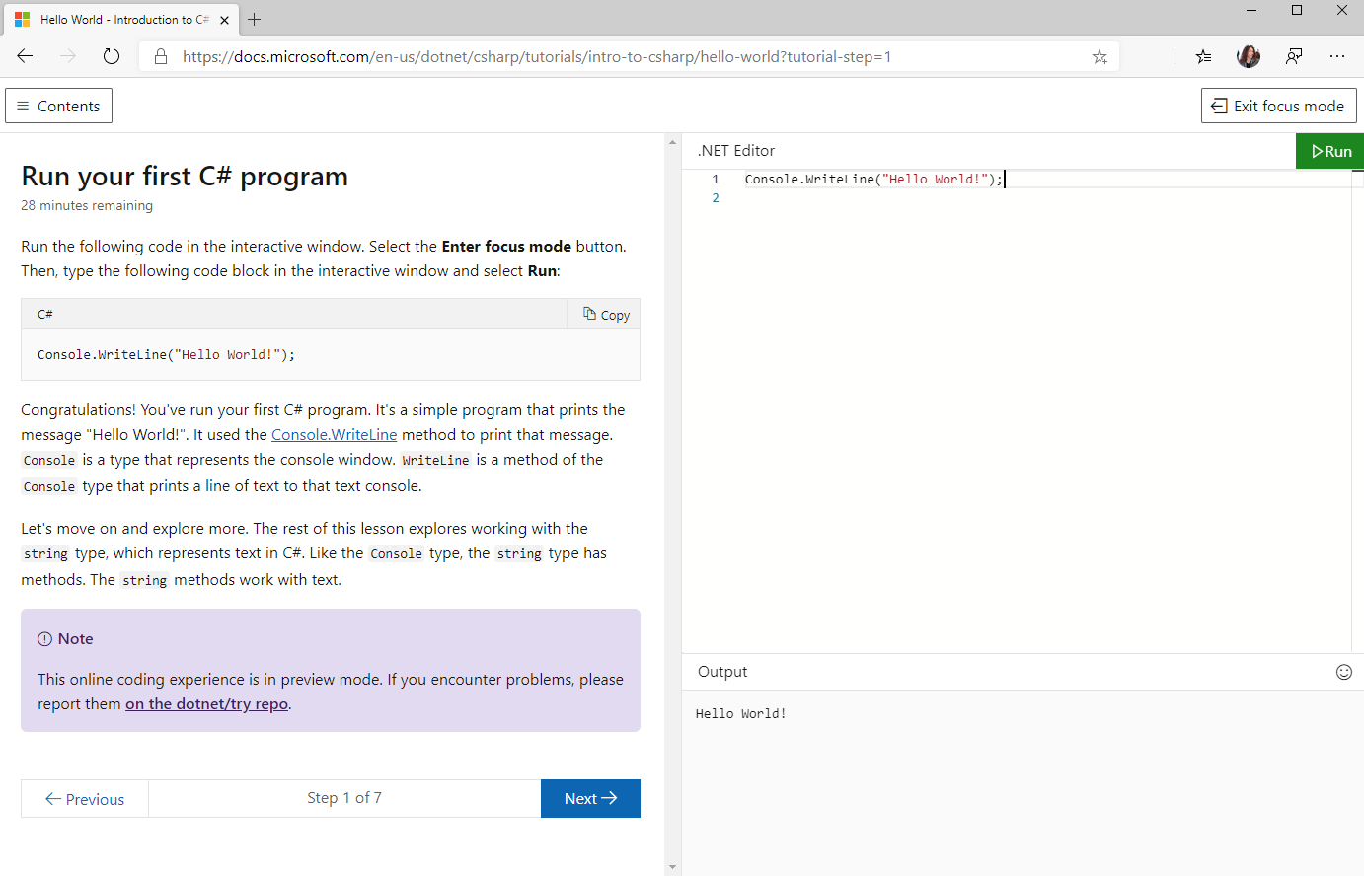
Try .NET
试一试在浏览器里跑 C# 和 .NET
使用 Blazor WebAssembly 在浏览器上本地运行代码，减少后端服务器压力
aka.ms/csharpintro

Slide 22
活跃的 Blazor 社区
https://aka.ms/awesomeblazor
开源免费的 组件 & JS 互操作 库
许多有趣的 Blazor 应用
文章, 视频, 博客, 和其他学习资料

Slide 23
Blazor Futures

Slide 24
Web
Blazor Server
Web app
Every interaction handled on server
Prerendered HTML (optional)
Blazor WebAssembly
Web app with client-side execution
Loaded from web server
Can work offline via Service Worker
Blazor PWA – OS installed
Appears as native app (own window)
Works offline or online
Blazor Hybrid
Native .NET renders to Electron / WebView
Appears as native app (own window)
Works offline or online
Desktop
+ Mobile
Blazor Native
Same programming model, but
rendering non-HTML UI

Slide 25
Blazor WebAssembly
2020 5.19 正式发布
初始版本基于.NET Core 3.1
模板会在 .NET Core 3.1 SDK 更新里面包含
这是属于当前版本, 不是长期支持版本
Blazor WebAssembly 已经进入.NET 5 并将随.NET 5的版本发布

Slide 26
Blazor WebAssembly 特性
.NET Standard 2.1
WebSockets + .NET SignalR client
Debugging (browser dev tools & Visual Studio)
Auto-rebuild
IL trimming
Brotli compression
Static web assets integration
Authentication options
Localization

Slide 27
Blazor Hybrid 实验
Blazor + Electron
https://aka.ms/blazorelectron
Blazor + WebWindow
https://aka.ms/webwindow
探索 Blazor Hybrid 场景也是.NET 5的一个主题

Slide 28


ANNOUNCING
Experimental Mobile Blazor Bindings
Build native mobile apps with Blazor
Use your familiar web skills: Razor, C#, CSS
Rich set of native mobile components
100% access to native APIs: GPS, Media, & more
Use existing ecosystem of NuGet libraries for mobile
All in .NET
aka.ms/mobileblazorbindings
Notes:
Use familiar web skills: Razor, C#, CSS
Rich set of native controls
Use the already vast ecosystem of .NET libraries for mobile
100% Access to Native APIs like GPS, sensors, bluetooth, media playback and media libraries, keyboard, and on and on
All in .NET (ie no req for other languages)
Powered by Xamarin
This is a first step in an experiment. To learn more, check out Eilon Lipton's session later today at 1pm PT. We hope you'll go hands-on with this and share your feedback.

Slide 29
.NET Schedule
May 2020
Blazor WebAssembly
Sept 2019
.NET Core 3.0
Nov 2019
.NET Core 3.1
LTS
Nov 2020
.NET 5.0
Nov 2021
.NET 6.0
LTS
Nov 2022
.NET 7.0
Nov 2023
.NET 8.0
LTS
.NET Core 3.0 released at .NET Conf in September
.NET Core 3.1 = Long Term Support (LTS)
.NET 5.0 release in November 2020
Major releases every year, LTS for even numbered releases
Predictable schedule, minor releases if needed

Slide 30
总结
使用C# 和 .NET构建全栈Web开发
富组件模型和UI框架
ASP.NET Core 应用集成
Blazor Server 已经在 .NET Core 3.1 LTS ，可以用于产品开发
Blazor WebAssembly 3.2.1 已可以用于产品开发
可以尝试体验 Blazor Hybrid & Native
可以从 https://blazor.net 开始blazor之旅!

